Slide 1


INTERACTION WITH
GITHUB

Slide 2

CONTENTS
Branching
Push
Clone
Push changes
Clone a repository
Pushing Changes to the Master
Clone operations

Slide 3

CLONE A REPOSITORY

Slide 4
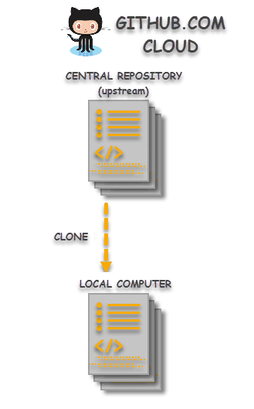
WHAT IS CLONING ?
Cloning is a process of creating an identical copy of a Git Remote Repository to the local machine.

Slide 5
Why clone a repository ?
Contribute to Organizational Projects:
A centralized system is required for organizations where multiple people work on the same code base. Cloning helps us achieve this motive.
By cloning, people can edit the project code to either fix some issue or provide some modifications i.e. an extra or extended feature.
Make use of Open Source Repositories:
If someone wants to use some functionality which has already been developed by someone else, then why to code it from scratch and waste time & resources? For e.g. there are unlimited open source repositories are available, which can directly fit into the projects.

Slide 6
Cloning an existing repository : git clone
git clone
Git clone is a Git command line utility which is used to target an existing repository and create a clone, or copy of the target repository.
git clone <repo>
Clone the repository＜repo＞on local machine.

Slide 7
Cloning a specific folder
git clone <repo> <directory>
Clone the repository ＜repo＞ into the folder called ＜directory> on the local machine.

Slide 8
git clone –branch
The -branch argument lets you specify a specific branch to clone instead of the branch the remote HEAD is pointing to, usually the master branch.
git clone -branch new_feature git://remoterepository.git
This above example would clone only the new_feature branch from the remote Git repository

Slide 9
git clone --recurse-submodules
The --recurse-submodules with git clone command,will automatically initialize and update each submodule in the repository,including nested submodules.
git clone --recurse-submodules https://github.com/ch/MainProject

Slide 10
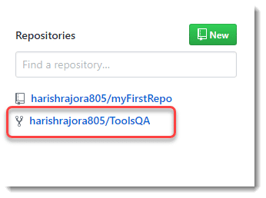
How to Clone a Repository or use Git Clone Command?
To clone a repository, go to the repository page which you want to clone. This can be done through the side column on your dashboard.

Slide 11
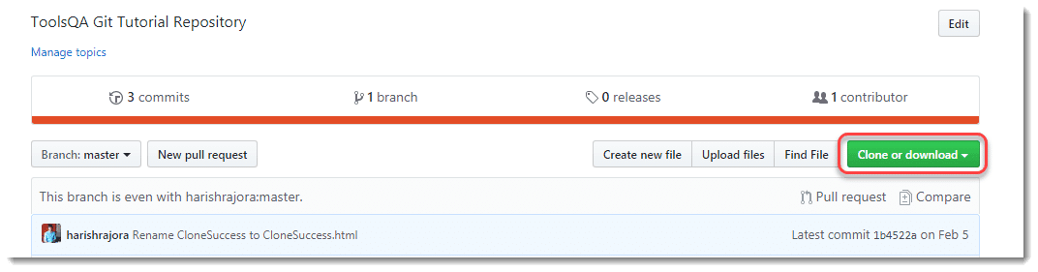
Press Clone or download button.

Slide 12
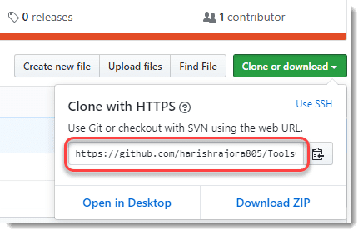
Copy the code that appears after pressing the button.

Slide 13
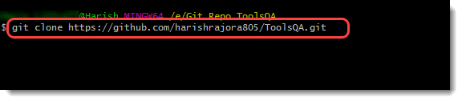
Once done, open Command prompt/Git bash on your system and press the following command to clone the repository:
git clone <repo>
Note: repo is the link of the repository over GitHub Cloud.

Slide 14
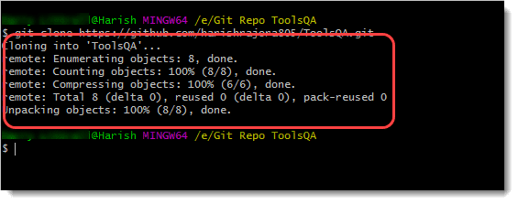
The following message will appear as you press enter.
Confirm the cloning by listing the directories using the ls command which lists all the files and folder or check in the local drive by navigating to it manually.

Slide 15

BRANCHING

Slide 16
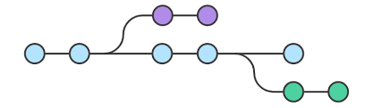
What is a Git Branch?
A branch represents an independent line of development. Branches serve as an abstraction for the edit/stage/commit process.

Slide 17
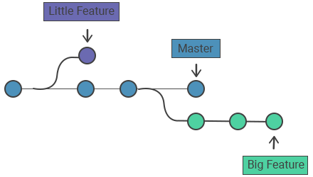
Branching enables you to isolate your work from others.
Changes in the primary branch or other branches will not affect your branch, unless you decide to pull the latest changes from those branches.
It is a common practice to create a new branch for each task (i.e., a branch for bug fixing, a branch for new features, etc.). This method allows others to easily identify what changes to expect and also makes backtracking simple.

Slide 18
Why do we need a Branch in Git and Why Branches Are Important?
Git branches come to the rescue at many different places during the development of a project.
Branches create another line of development that is entirely different or isolated from the main stable master branch.

Slide 19
For example:
Consider that you are developing a project with your team, and you finish a feature. You contact the client to request them to see the feature, but they are too busy, so you send them the link to have a look at the project.
We can do the project in two ways:
Project Development through linear development
Development through Branching :
Branches give you the freedom to independently work on different modules (not necessarily though) and merge the modules when you finish developing them.
Git branches are swift to be created and destroy
Branches in Git help the team, which are in different parts of the world, work independently on independent features that would ultimately combine to produce a great project.

Slide 20
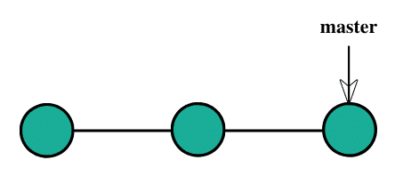
Developing the project through branching.
You have been working on a project with the client being happy until this point.

Slide 21
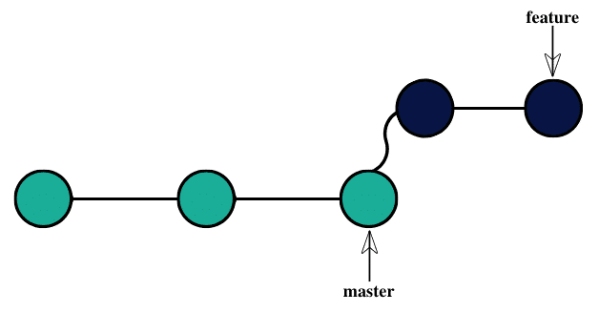
After that, you decide to develop a feature and create a new branch called feature for the same purpose and start working on it.
You show this to your client.

Slide 22
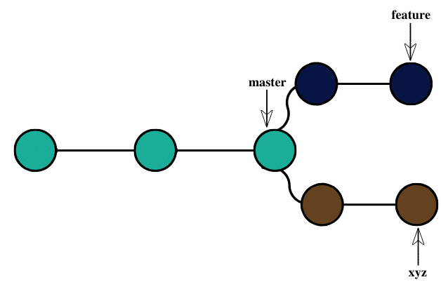
In the meantime, you decide to develop another feature and wait for the client’s approval.

Slide 23
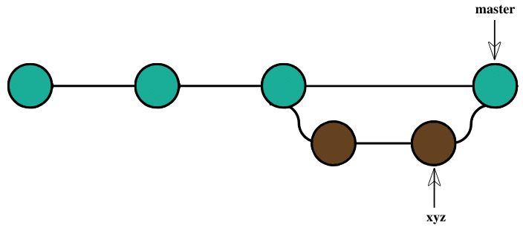
The client disapproves of the feature and requests to delete it.
Now, since you were following the branched strategy, you need to remove the branch, and all the remaining code remains as it is. The new feature can be easily added to the master branch to achieve the following.

Slide 24

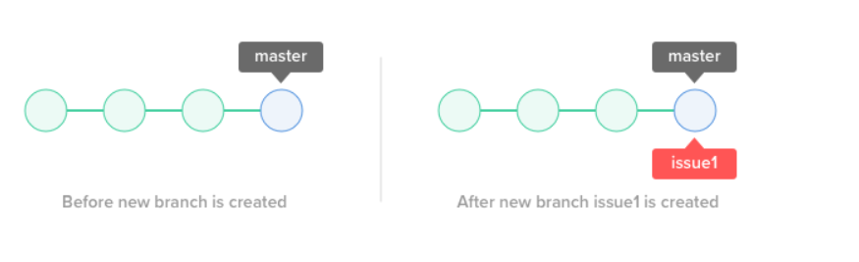
Create a Branch
Creating a new branch does not change the repository; it simply points out the commit.
For example, let's create a branch called “issue1” using the command git branch.
The illustration below provides a visual on what happens when the branch is created. The repository is the same, but a new pointer is added to the current commit.

Slide 25
git add -- .
Commit Changes
The parameter -a tells git to automatically stage files that have been modified and/or deleted. and -m tells git that you provide a commit message.
git commit -a -m 'Adding my files'
This commits the files.
Add Files
This adds your new files for git to track in the new branch.

Slide 26

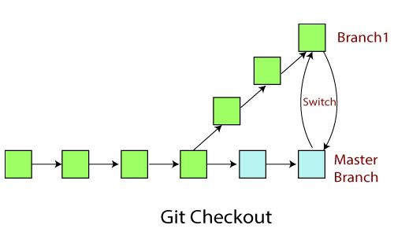
Git Checkout
The "checkout" command can switch the currently active branch - but it can also be used to restore files.
The most common use case for "checkout" is when you want to switch to a different branch, making it the new HEAD branch.

Slide 27
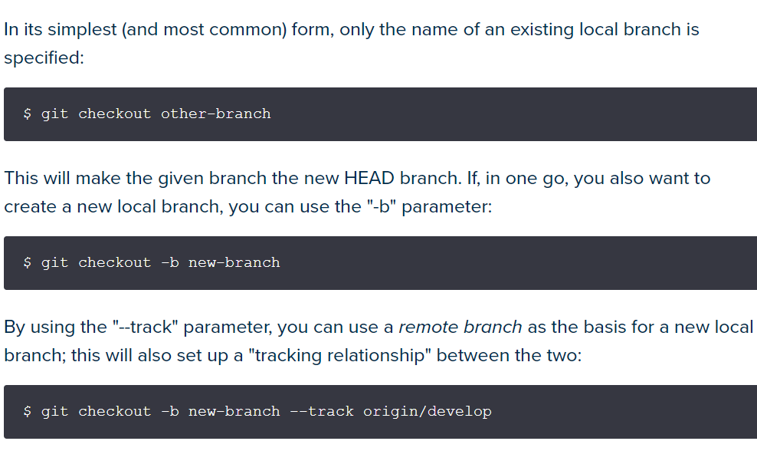
Usages

Slide 28
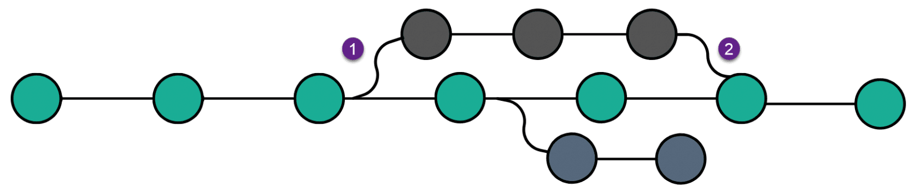
Merge a branch
A single repository generally contains multiple branches in Git.
Git merge is used to combine two branches.
A merge operation can be executed by typing the command
git merge <branch_name>
The top branch merges into the master branch after three commits.

Slide 29
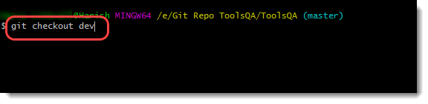
To merge branch in Git to another branch
To merge a branch called “dev” into another branch called the “master” branch.
Before merging, we need to log some changes into the branch. For this, let’s switch to the branch that we will merge by the following command:

Slide 30
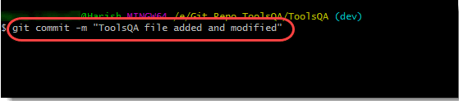
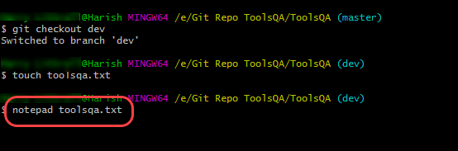
Now open a file using notepad and make some changes to the file. (Create a file if there is none).
Close the file and commit these changes (After adding the file to the staging area).

Slide 31
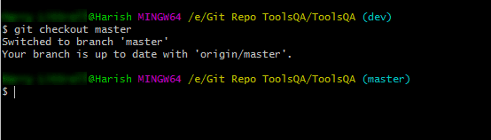
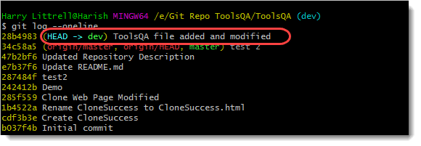
Perform Git Log operation to check the commit using oneline flag.
Now switch to the branch to which we will merge the changes (master in this example).

Slide 32
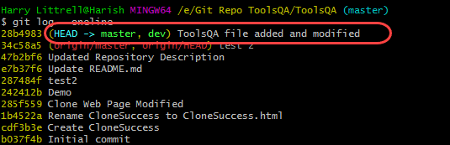
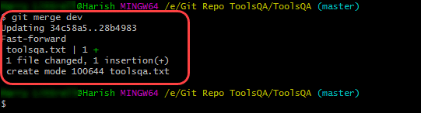
Execute the following command to merge the branch dev to the branch master.
git merge <branch_name>
The output will show a successful merge along with the file name, i.e., toolsqa.txt. Recheck the log to see the merge.

Slide 33
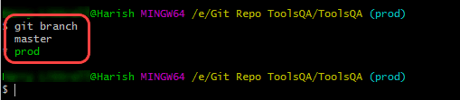

Delete a Branch
First list out all the branches in the local repository with the command:
git branch
To delete a branch on your local system, follow these simple steps:
Type in the following command:
git branch -d <branch_name>
The “d” flag used here specifies that we intend to delete a branch.

Slide 34
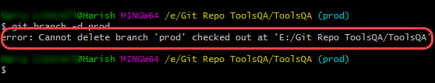
Note: We can’t delete a branch we are currently working on.
Git suggests us to “check out” from this branch and try deleting again.
We can use git branch -d <branch_name> to force delete a branch without checking the merged status of the branch.

Slide 35

PUSH AND PULL

Slide 36
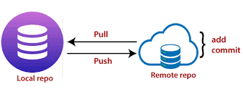
PUSHING
Pushing sends your changes up to GitHub, so they can be shared with the rest of the world
It also serves as a hedge against data loss.

Slide 37
The simple command to PUSH from a branch is:
git push 'remote_name' 'branch_name'
git push command is used to transfer or push the commit.
remote_name is the name of the remote repository to which we are pushing the changes.
branch_name is the branch the user is pushing to the remote repository.

Slide 38
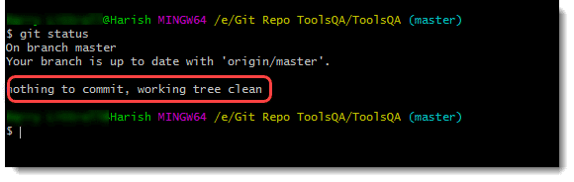
First, check that you have a clean repository through git status command (no pending changes to commit).
HOW TO PUSH ?

Slide 39
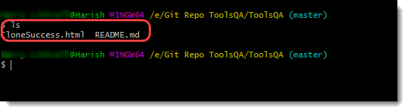
On branch master : Denotes that we are currently on the ‘master’ branch. Since there are no other branches yet, we are on the master branch by default.
Your branch is up to date with origin/master : Origin is the name of the remote repository that we gave while connecting the local repository with the remote repository.
List all the files with the ls command in the repository.

Slide 40
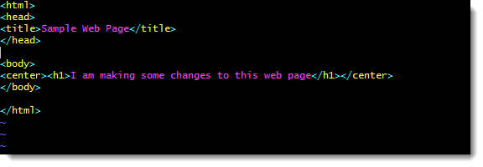
Since there is only one file (README.md i). let’s make some changes to its content.

Slide 41
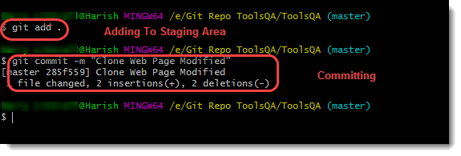
2. Add the changes made to the staging area and commit these changes.

Slide 42
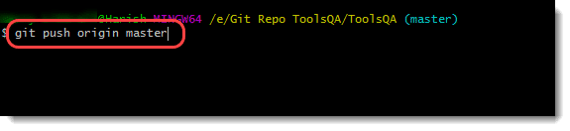
3. Type the following command to push these changes into your GitHub
git push origin master
repository and press enter.

Slide 43
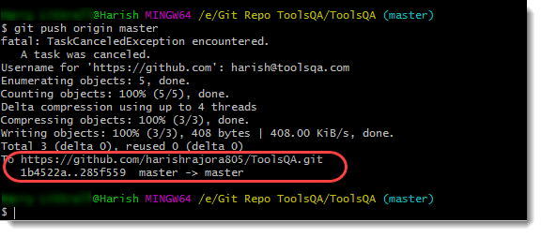
4. User will get the following message in Git Bash.
master -> master: The line master-> master shows the source branch from which merging happens to the destination branch. In the above scenario, both are master branches.
Writing Objects: 100% all the changes have been successfully pushed onto the cloud.

Slide 44
Status tells us we have no local changes pending,but that the remote is one commit behind.
This isn't actually checking against the remote repository, just letting us know how many times we've committed since our last push.
git status
git remote -v
Check out where our remote target is.We will revisit this in a bit,when we start working on syncing to the original repository.

Slide 45
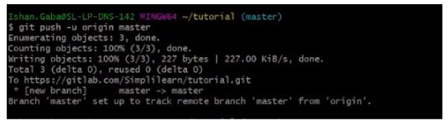
git push -u origin master
push the changes in branch master to remote location origin, and remember the settings (-u).

Slide 46
Git Fetch Command
git fetch command helps the user download commits, refs, and files from the remote repository to the local repository.
Git fetch is a great way to stand at a place from where you can see the changes and decide if you want to keep them or discard them.

Slide 47
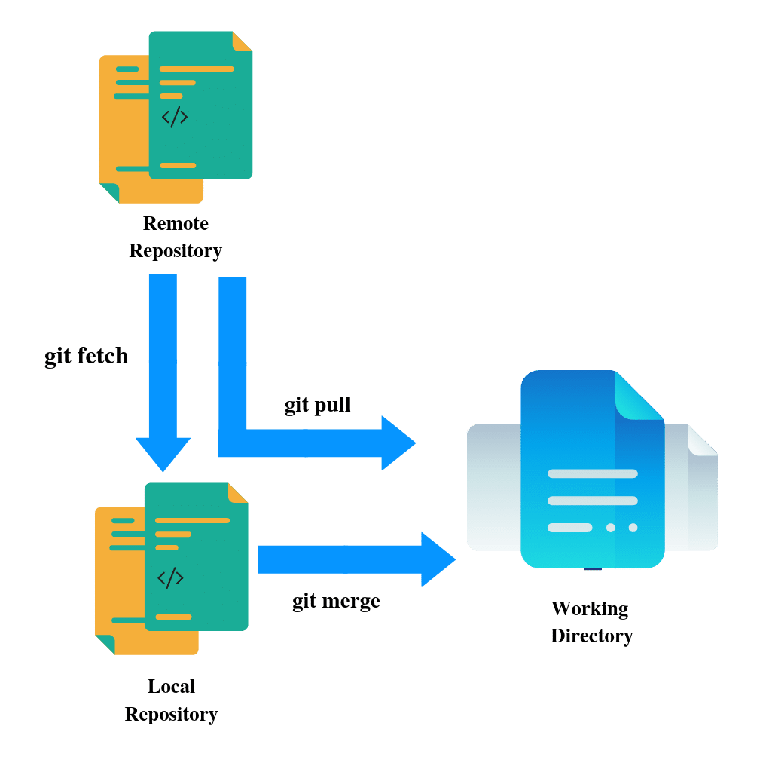

Slide 48
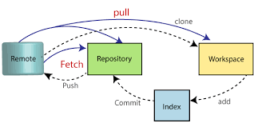
opposite of pushing
retrieves changes from the remote location and applies them to your local repository
more useful in a group environment where more than one person is submitting changes to a single repository
PULLING

Slide 49
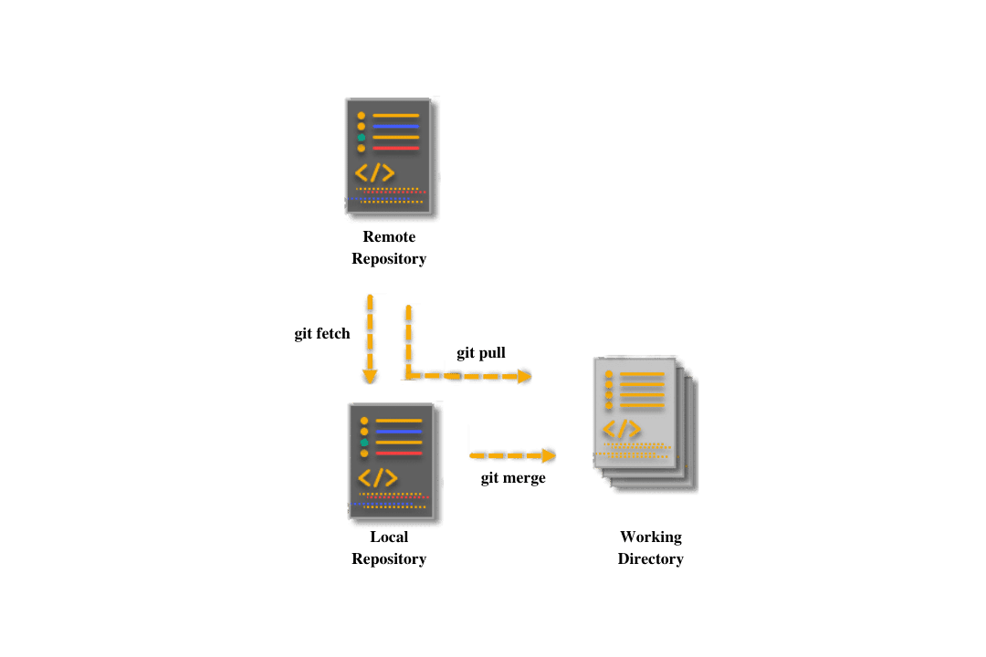
Git pull: a magical way to perform a combined operation of git-fetch & git-merge with a single command

Slide 50
The git pull command is a combination of git fetch
'remote_name' is the repository name and 'branch_name' is the name of the specific branch.
The simple command to PULL from a branch is :
git pull 'remote_name' 'branch_name'.

Slide 51
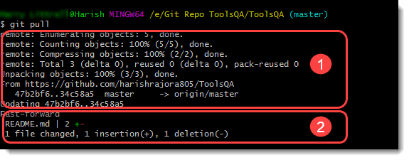
HOW TO PULL?
We can use the git pull command by typing the following command in the Git Bash.
git pull
Cont.

Slide 52
The first section has the same output as the git fetch command whereas the second section has the same output as the git merge command. It proves git pull is an amalgam of git fetch and git merge command.

Slide 53
THANK YOU

